Slide 1
5CS021
NUMERICAL METHODS AND CONCURRENCY

Slide 2
LECTURE -1
Variable types, conditions, loops and functions

Slide 3

Numerical Methods
The area of mathematics and computer science that creates, analyses, and implement algorithms for obtaining numerical solutions to problems.
Most of the time these methods yield an approximate solution.
Problem like:
p(x) = x⁷ − 28x⁶ + 322x⁵ − 1,960x⁴ − 6,769x³ − 13,132x² + 13,068x − 5,040
can be solved approximately using Numerical methods.

Slide 4
What is Parallelism ?
Parallel programming is the process of using a set of resources to solve a problem in less time by dividing the work.
It increases performance of the software

Slide 5
Characteristics:
Parallelism is performing many task at the same time.
It is the use of multiple resources(e.g. Cores) to solve a problem.
Parallelism is doing lots of things at once.
Problem
Instruction
CPU
CPU
CPU
CPU
tN
t3
t2
t1

Slide 6
What is Concurrency?
Concurrency is the execution of the multiple instruction sequences at the same time. It happens in the operating system when there are several process threads running in parallel.

Slide 7
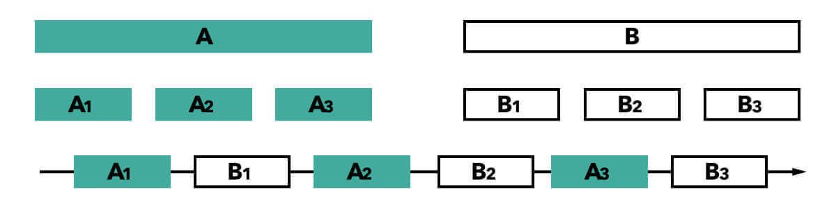
Characteristics :
Dealing with multiple things at a time.
The important detail here is that the tasks don’t necessarily execute at the same time, but they can be divided into smaller tasks that can be interleaved.

Slide 8
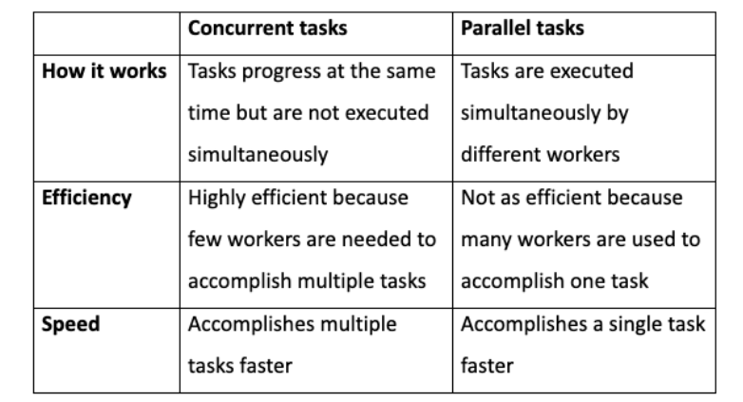

Slide 9
Basic C program

Slide 10
Output
Input
Something

Slide 11
Input / Output function
Reads
Generates
Input
Output

Slide 12
Input / Output function
Reads
Need an input function
Input

Slide 13
Input / Output function
Generates
Need an output function
Output

Slide 14
getchar()
Fetches a character from standard input
putchar()
Sends a character to standard output

Slide 15
The getchar() and putchar() Function
Require the stdio.h header file included

Slide 16
C Library Output Functions
printf(), putchar(), puts()
Send one or more character to output
Requires the stdio.h header file
Part of standard C library

Slide 17
#include <stdio.h>
void main()
{
printf(“Hello world”);
}

Slide 18
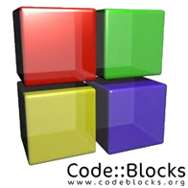
#include <stdio.h>
int main()
{
return(3);
}

Slide 19
Escape Sequences
“Behold! I am a string of text.”
“Behold! \n I am a string of text.”
Output:
“Behold!
I am a string of text.”

Slide 20
Data Types

Slide 21
What are Data types?
It is declarations for variables.
Need of data types:
It tells the computer system how to interpret its value.
It ensures that data is collected in the preferred format and the value of each property is as expected.

Slide 22
Numbers:
int (integer) – whole number
double – decimal number
float – similar to double but less precision (only use when computing thousands of low decimal point numbers)
long – whole number but allows bigger numbers than int
long long – whole number (bigger than long)

Slide 23
Unsigned variables hold just positive numbers
Unsigned int – whole number (0 to 4,294,967,295)

Slide 24
Char - single character
e.g. char ch=‘A’
Strings in C are known as char arrays
Char name[ ] = “Hiran”
Char name[5] = “Hiran”

Slide 25
Printing variables in C

Slide 26
‘C’ uses format specifiers to print out certain types of variables.
In java, you can use just the variable name, in C, you need to specify the type of variable within a printing function known as printf.

Slide 27
Simple print in C:
Printf(“Hello World”)
int num = 10;
printf(“%d”, num) or printf(“num = %d”, num)
Output : 10 or num = 10

Slide 28
To print a char array:
char name[ ] = “Hiran”;
printf(“My name is %s”, name);
Output : My name is Hiran

Slide 29
To print a char array:
char name[ ] = “Hiran”;
printf(“My name is %s”, name);
Output : My name is Hiran

Slide 30
Scanf()
scanf() is used to take user input
& (address operator) gives address of a variable
Needed because scanf() places input value at a variable address
int age;
printf(“Enter your age:”);
scanf(“%d”, age);
printf(“Your age is: %d”, age);

Slide 31
Format specifiers when printing variables

Slide 32
What are format Specifiers ?
Format specifiers in C are used to take inputs and print the output of a type.
Need of format Specifiers :
Used in c for input and output purposes
Helps compiler to understand what type of data is used in variable.

Slide 33
int : printf(“%d\n”, var)
long : printf(“%ld\n”, var)
//Long (long integer) variables are stored as signed 32-bit (4-byte) numbers ranging in value from -2,147,483,648 to 2,147,483,647.
long long : printf(“%lld\n”, var)
char var[ ]: printf(“%s\n”, var)
double : printf(“%lf”, var)
float : printf(“%f”, var)
float with precision : printf(“%f.4”, var)
//prints to 4 decimal places

Slide 34
If statements (conditions)

Slide 35
int num = 10;
if(num < 20)
{
printf(“Num is less than 20”);
}
printf(“Bye”);

Slide 36
If/else statements (conditions)

Slide 37
int num = 10;
If(num < 20)
{
printf(“Num is less than 20”);
}
else
{
printf(“Num is not less than 20”);
}

Slide 38
Switch Statement

Slide 39
int num = 8;
switch (num) {
case 7:
printf("Value is 7");
break;
case 8:
printf("Value is 8");
break;
case 9:
printf("Value is 9");
break;
default:
printf("Out of range");
break;
}

Slide 40
For Loop

Slide 41
int i;
for (i=1; i<= 5; i++)
{
printf(“Hello”);
}

Slide 42
While Loop

Slide 43
int i = 0;
While(i < 5)
{
printf(“%d”, i);
i=i+1;
}

Slide 44
Do While Loop

Slide 45
int i = 1;
do
{
printf("i=%d\n", i);
i=i+1;
}
while(i <= 3);
printf("Now value of i is %d", i);
}

